Slide 1

Final Project Data Analytics
Impact of gas extraction on Dutch real estate value and demand
Maurits Siemonsma
Ironhack Data Analytics Bootcamp FTAUG24

Slide 2



Slide 4


Slide 5


Slide 7


Slide 8
Research objective
Context and key facts
Definitions
Hypotheses formed
Factors
Data and techniques used
Findings
Conclusion
Challenges
Limitations
To update on all pages!
Outline
Research objective
Context and key facts
Data and techniques used
Definitions
Hypotheses formed
Factors and independent variables
Findings
Conclusion
Challenges
Limitations

Slide 9
Research Objective
The Research objective is to find a relationship between the natural gas extraction in the Province of Groningen and its local real estate value

Slide 10
History and key facts
1,120 induced earthquakes since 1997
267,466 damage claims made due to earthquakes
85,000 addresses affected
Notes:
Historical background
Why are they extracting? How much?
Damages, figures
What do locals think about this?
Controversies

Slide 11
Context and key facts (cont.)

Slide 12
History and key facts (cont.)
1959: gas discovery in Groningen, Netherlands
1963: start gas extraction
1963 - 19 April 2024: 2,246 billion cubic meters gas extracted
363 billion Euros benefitted to Dutch government

Slide 13
Context and key facts (cont.)
https://public.tableau.com/app/profile/maurits.siemonsma/viz/fp_choroplethsstacked/StoryFPIH?publish=yes

Slide 14
Data and techniques used
Type of analysis: Explorative Data Analysis with hypothesis testing
Tools used: Jupyter, SQL, Tableau
???

Slide 15
Definitions
Text
Text
Text

Slide 16

Hypotheses formed
H_1: Gas extraction has negatively impacted local real estate value
H₀: There is no significant difference in real estate value with the benchmark
H₁: There is a significant lower difference in real estate value with the benchmark
H_2: Areas impacted by gas extraction are more availabe than areas that are not impacted
H₀: There is no significant difference in occupation rate with the benchmark
H₁: There is a significant lower difference in occupation rate with the benchmark

Slide 17

Factors and independent variables
Primary variables that influence real estate prices are:
Interest rates
Economical attractiveness of area
Infrastructure
Demographics
Availability

Slide 18
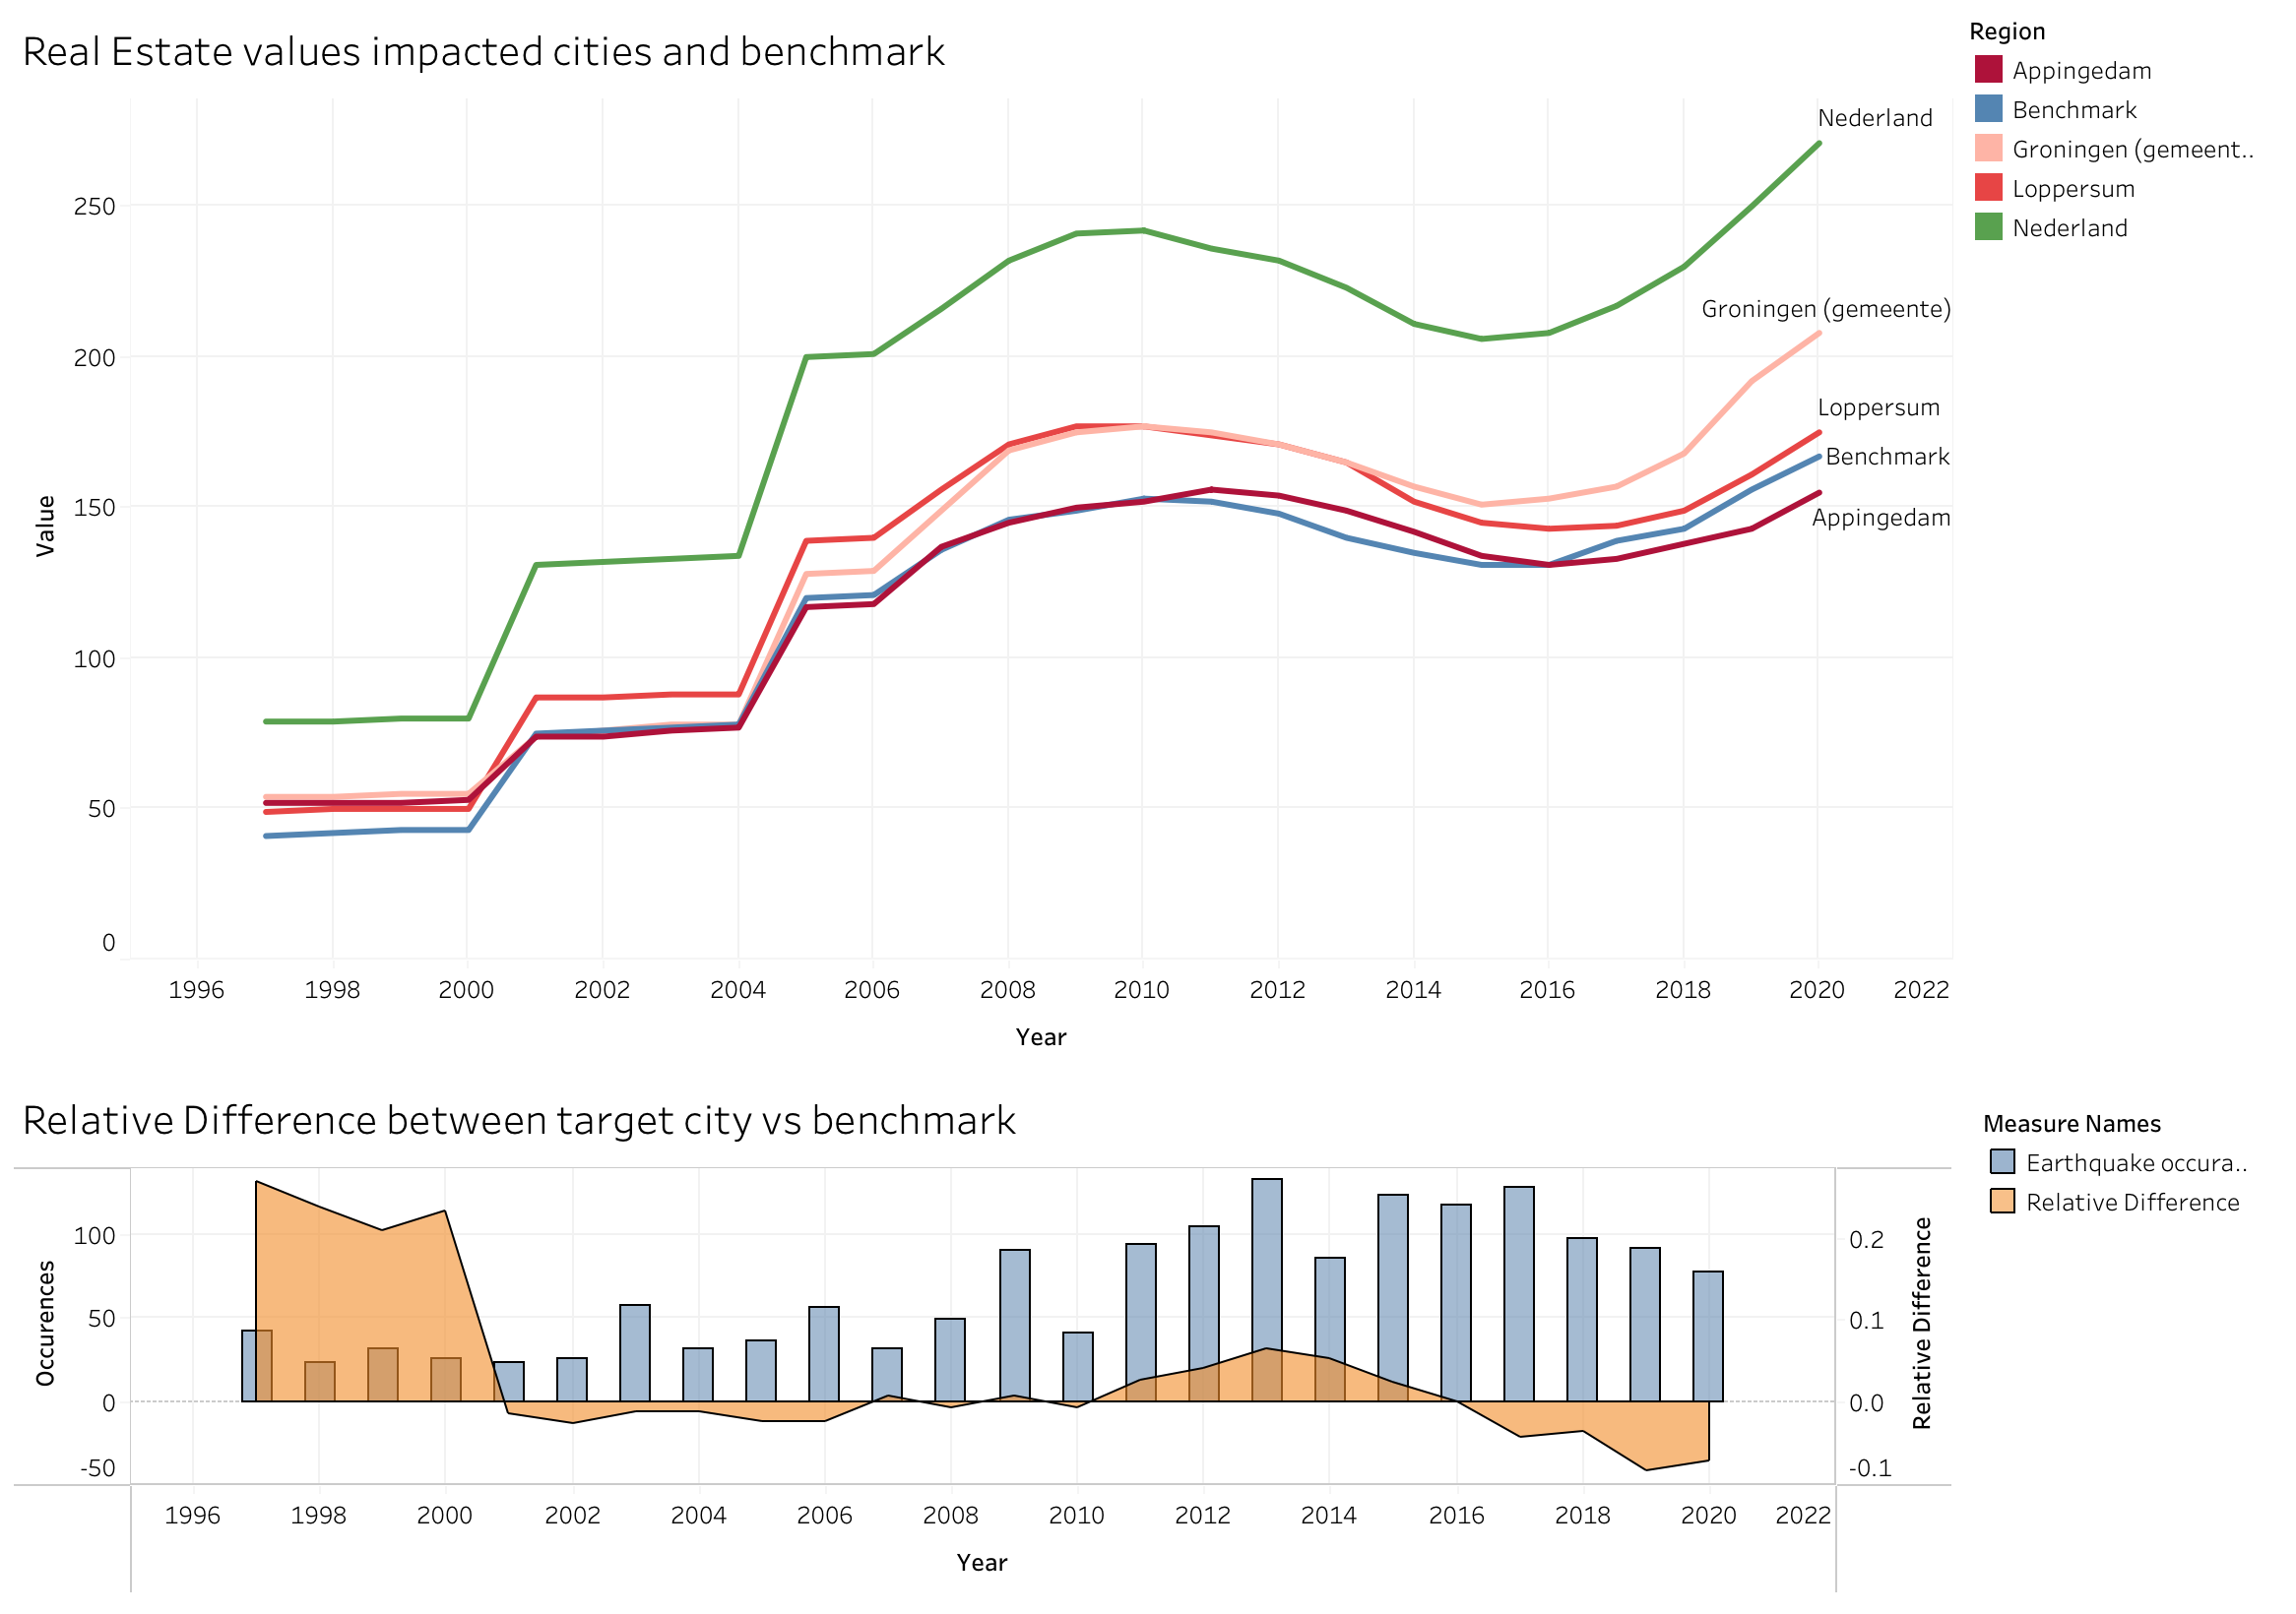
Findings: Real Estate value for affected cities and Benchmark

Slide 19
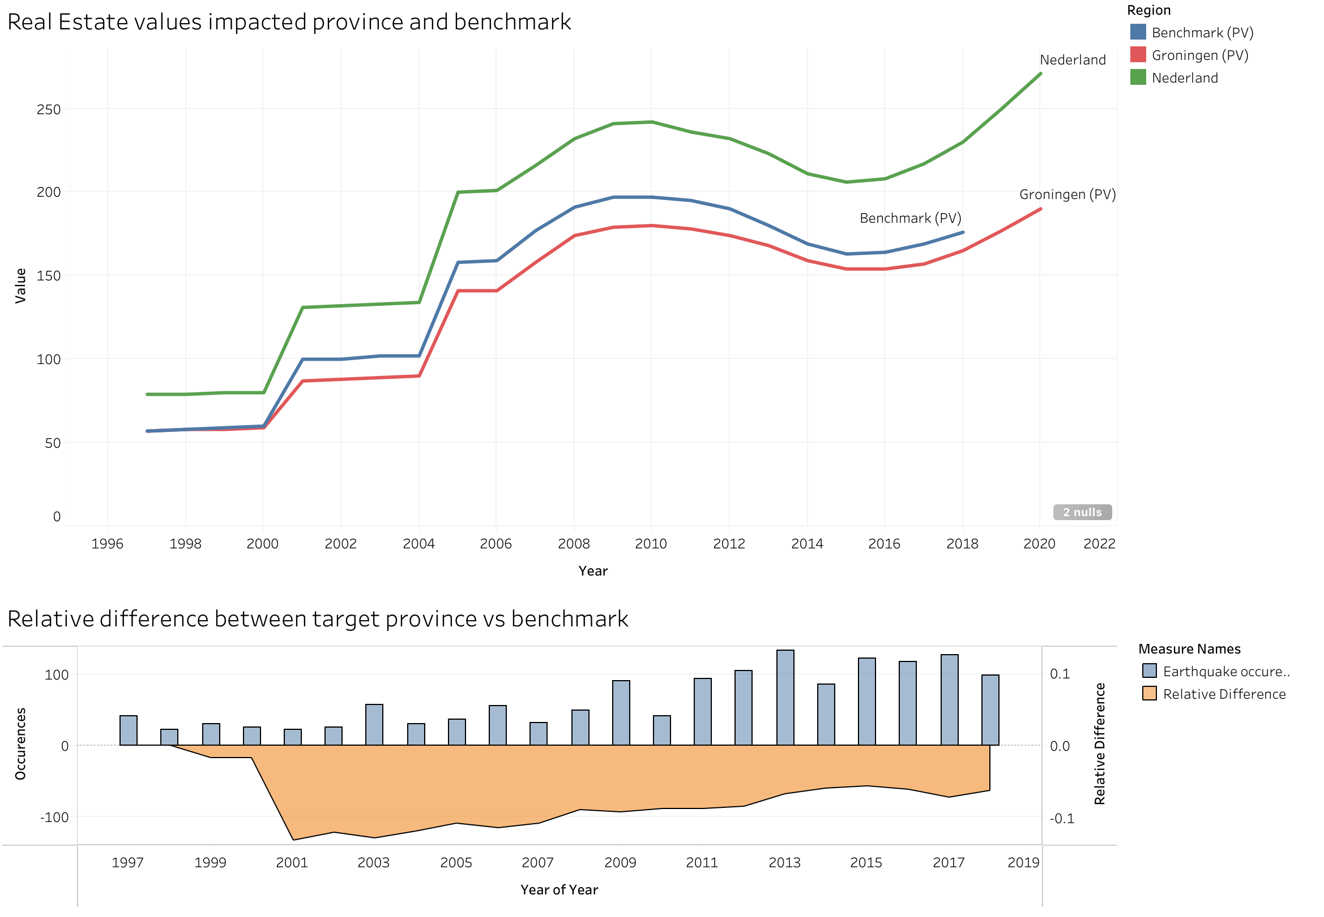
Findings: Real Estate value for affected region and Benchmark

Slide 20
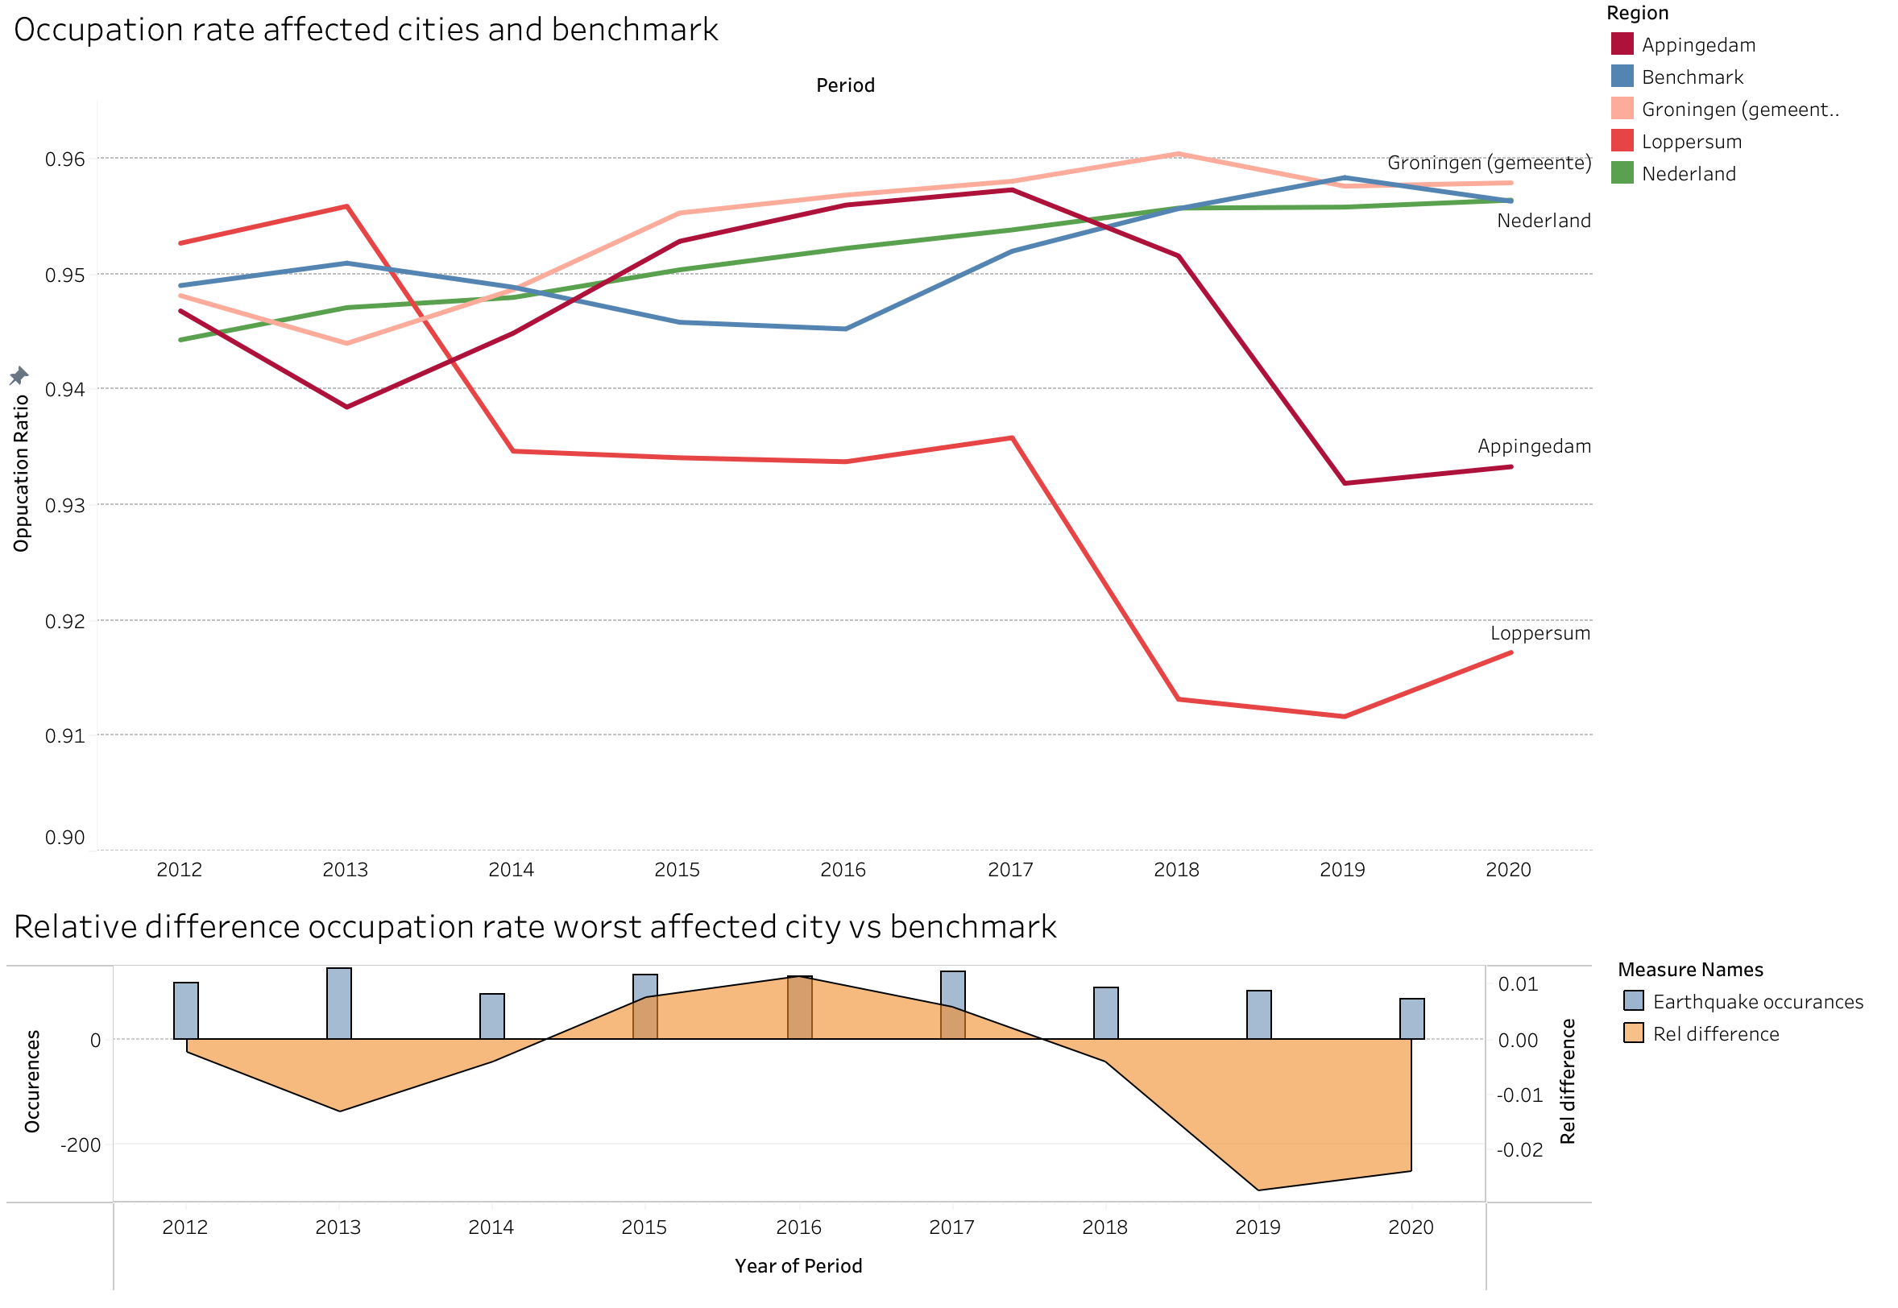
Findings: Occupation rate for affected cities and benchmark

Slide 21
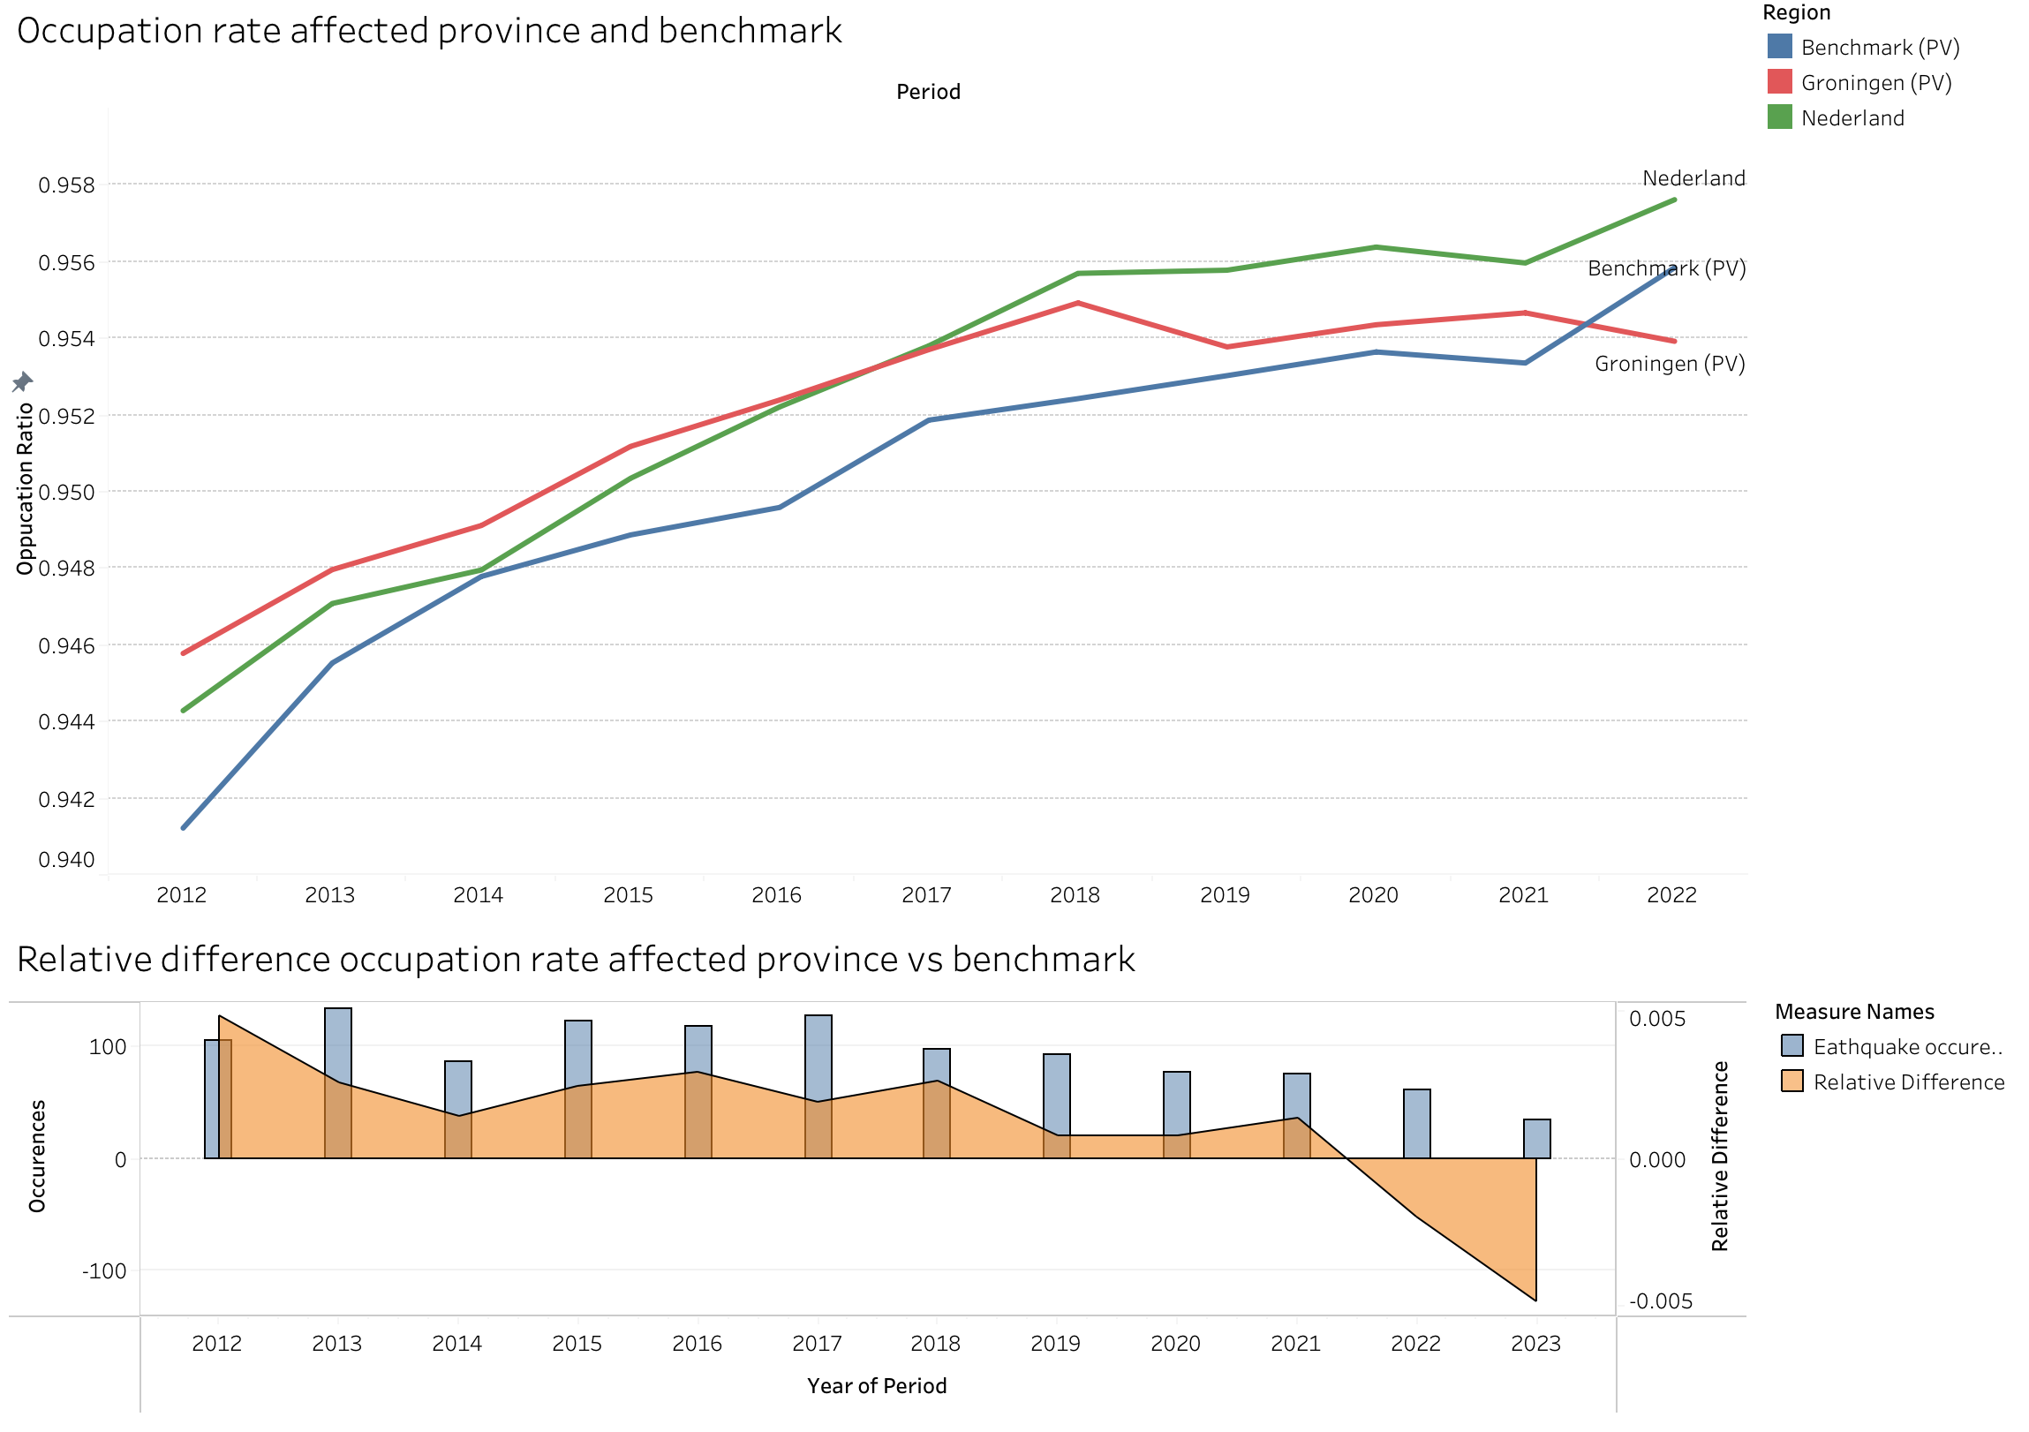
Findings: Occupation rate for affected region and benchmark

Slide 22
Hypothesis testing

Slide 23
Conclusion
Due to many factors influencing real estate value, the value itself may not be a good parameter to establish a conclusion that gas extraction has a negative impact, however, housing availability may indicate that there is a lower demand for living there.

Slide 24
Challenges
Text

Slide 25
Limitations
Due to a high number of independent variables that influence real estate prices, lowered real estate prices and higher availability ratios may not be enough to conclude that earthquakes are to blame for this
More indept research needs to be done to include more independent variables. However, due to the uniqueness of each region, finding appropriate benchmarks will still be very difficult.

